Slide 1
Digital Portfolio
STUDENT NAME: KARTHI S
REGISTER NO :20324U48015
NMID: A30921DCECE63DDAFC546849EB2C83A5
DEPARTMENT: B.Sc DATA SCIENCE
COLLEGE: DR.M.G.R.CHOCKALINGAM ARTS COLLEGE
UNIVERSITY: THIRUVALLUVAR

Slide 2
PROJECT TITLE
A Personal Web Showcase

Slide 3
AGENDA
Problem Statement
Project Overview
End Users
Tools and Technologies
Portfolio design and Layout
Features and Functionality
Results and Screenshots
Conclusion
Github Link

Slide 4

PROBLEM STATEMENT
In today's competitive digital world, having a professional online presence is essential for individuals seeking to showcase their skills, experience, and projects effectively. Many aspiring developers and professionals struggle to present their work in a well-organized, visually appealing, and accessible way to potential employers or clients.

Slide 5

PROJECT OVERVIEW
The Digital Portfolio Website project involves designing and developing a personal website that serves as a professional showcase for an individual's skills, projects, and contact information. Built using HTML, CSS, and JavaScript, this responsive website will provide an intuitive and visually appealing interface accessible across devices.

Slide 6

WHO ARE THE END USERS?
The end users of the Digital Portfolio Website include:
Potential Employers and Recruiters
Individuals or companies looking to evaluate your skills, experience, and projects when considering you for job opportunities or internships.
Clients and Collaborators
People or organizations interested in hiring your services for freelance projects or collaborations.
Peers and Fellow Developers
Other professionals who want to learn about your work, exchange ideas, or connect for networking purposes.
General Visitors

Slide 7

TOOLS AND TECHNIQUES
Tools:
HTML — to create the structure of the website
CSS — to style the website and make it look good
JavaScript — to add interactive features like form submission
Code Editor (like VS Code) — to write and edit the code
Techniques:
Responsive Design — so the website works well on phones and computers
Basic Form Validation — to check if the contact form is filled correctly
Simple Navigation — easy to move between sections on the page

Slide 8
POTFOLIO DESIGN AND LAYOUT
Header: Shows your name and menu links (About, Projects, Skills, Contact).
Hero Section: Big welcome message with your name and a short intro.
About Me: A few sentences about you.
Projects: List of your projects with title and description.
Skills: Simple list of your skills.
Contact: A form to send you messages.
Footer: Your copyright info.
The website is easy to read and works well on phones and computers.
8

Slide 9
FEATURES AND FUNCTIONALITY
Easy Navigation: Menu links to jump to different sections on the page.
Responsive Design: Looks good on phones, tablets, and computers.
Project Showcase: Display your projects with titles and descriptions.
Skills List: Show your main skills clearly.
Contact Form: Visitors can send you messages directly from the website.
Form Validation: Checks that the contact form is filled correctly before sending.
Clean Design: Simple and professional look that is easy to read.

Slide 10
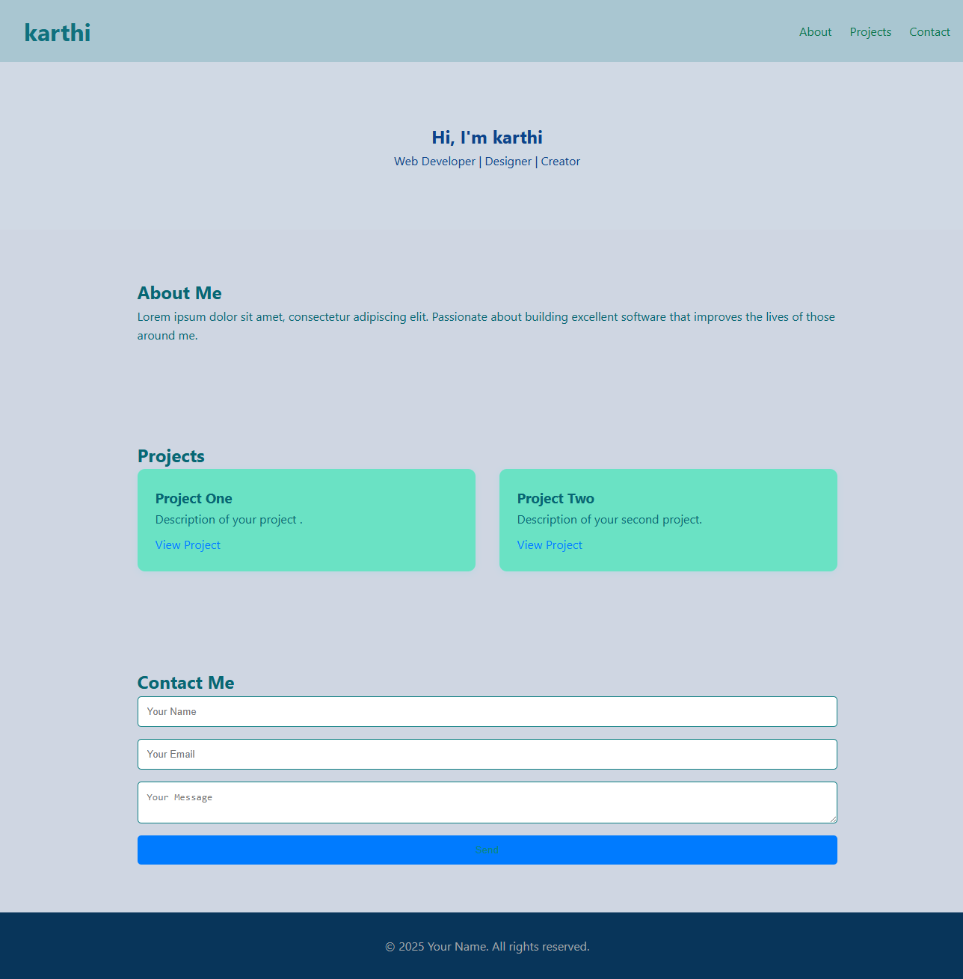

RESULTS AND SCREENSHOTS
3/21/2024 Annual Review
10

Slide 11
CONCLUSION
The image you uploaded contains the word **"CONCLUSION"** in bold, uppercase text.
If you’d like help writing a conclusion for something specific (like an essay, report, presentation, etc.), just let me know the topic and what you've already covered — I can help you craft a clear and effective conclusion!
11

Slide 12

GITHUB LINK
https://github.com/10-karthi-12/Digital-Portfolio.git

